Slide 1


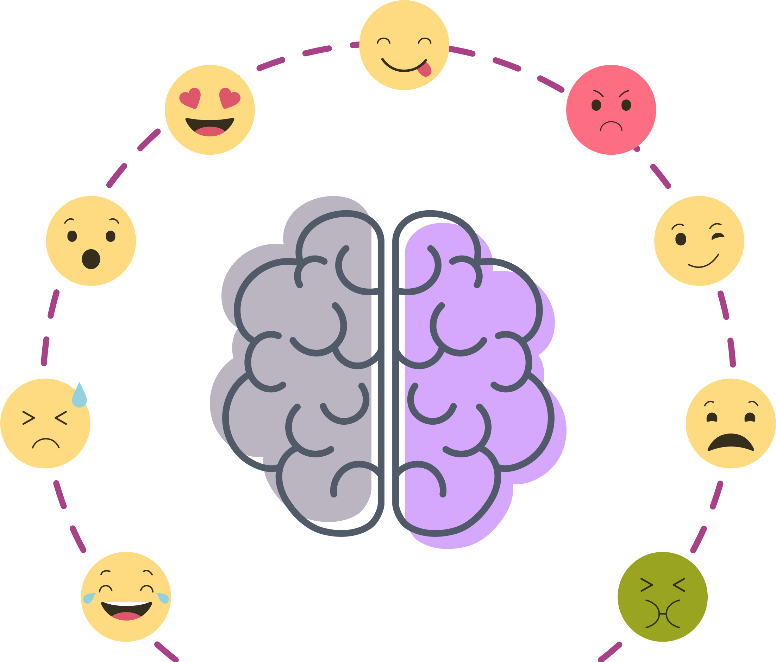
Emotional Speech Detector
Project Overview
Capstone Project – AI Bootcamp
Reem Basho, Yasmine Hariri, Rand Al Yaman, & Mahdi Dagher

Slide 2
Emotional Speech Detector
Outline
Project Overview
Capstone Project – AI Bootcamp
Reem Basho, Yasmine Hariri, Rand Al Yaman, & Mahdi Dagher

Slide 3
Emotional Speech Detector
Outline
Project Overview
1
Introduction
2
Methodology
3
Implementation and Results
4
Model Demonstration

Slide 4
Emotional Speech Detector
Introduction
Outline
1
Introduction
2
Methodology
Capstone Project – AI Bootcamp
Reem Basho, Yasmine Hariri, Rand Al Yaman, & Mahdi Dagher
3
Implementation and Results
4
Model Demonstration

Slide 5
Emotional Speech Detector
Importance of Emotional Speech Detection
Introduction
Problems and Challenges
Objectives of the Project
Capstone Project – AI Bootcamp
Reem Basho, Yasmine Hariri, Rand Al Yaman, & Mahdi Dagher
Literature Gap and Novelty
Contributions of This Project
Literature Gap and Novelty
Outline
1
Introduction
2
Methodology
3
Implementation and Results
4
Model Demonstration

Slide 6
Emotional Speech Detector
Introduction
Importance of Emotional Speech Detection
Problems and Challenges
Capstone Project – AI Bootcamp
Objectives of the Project
Reem Basho, Yasmine Hariri, Rand Al Yaman, & Mahdi Dagher
Literature Gap and Novelty
Methodology
Contributions of This Project
Outline
2
Methodology
3
Implementation and Results
4
Model Demonstration

Slide 7
Introduction
Materials, Software, and Equipment Used
Datasets
Methodology
Importance of Emotional Speech Detection
Problems and Challenges
Objectives of the Project
Literature Gap and Novelty
Literature Gap and Novelty

Slide 8
Introduction
Methodology
Materials, Software, and Equipment Used
1
Software and Libraries
2
Preprocessing pipeline
3
Data

Slide 9











Introduction
Methodology
Materials, Software, and Equipment Used
1
Software and Libraries
2
Preprocessing pipeline

Slide 10
Introduction
Methodology
Materials, Software, and Equipment Used
1
Software and Libraries
Standardized to 16 kHz
Removed silence (leading/trailing)
Wiener filtering for noise reduction
HP/LP filtering + peak normalization
Segmented into 3s windows (50% overlap)
Kept utterance segments together (no leakage)
2
Preprocessing pipeline

Slide 11
Datasets
Crema-D
RAVDESS
Emo-DB

Slide 12
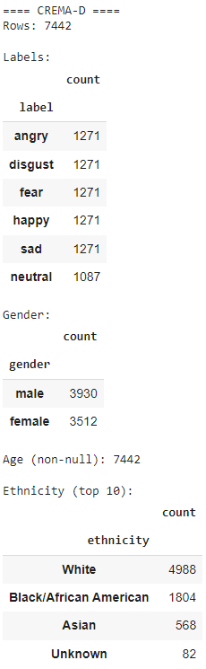
Datasets
Crema-D
RAVDESS
Emo-DB
The CREMA-D dataset is a large, publicly available collection of audio-visual clips from 91 actors, designed for training and evaluating speech emotion recognition (SER) models

Slide 13
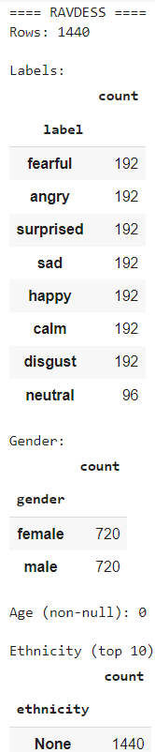
Datasets
Crema-D
RAVDESS
Emo-DB
The RAVDESS (Ryerson Audio-Visual Database of Emotional Speech and Song) dataset is a validated multimodal database of emotional speech and song recordings by 24 professional actors (12 male, 12 female).

Slide 14
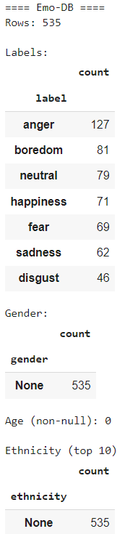
Datasets
Crema-D
RAVDESS
Emo-DB
The EMODB (German Emotional Speech Database) is a widely used German-language dataset of acted emotional speech, created by TU Berlin for analyzing how emotions are expressed in voice

Slide 15
Introduction
Methodology
Data Cleaning
Deterministic Cleaning
Resampling: Resampled all audio to 16kHz to standardize sample rate across datasets.
Silence Trimming :Removed leading and trailing silence using a decibel threshold of 40 dB.
High-pass filter at 60 Hz to remove low-frequency hum.
Low-pass filter at 7800 Hz to remove high-frequency noise.
Noise Reduction: Applied to reduce background noise while preserving speech clarity.
Peak normalization to unify amplitude levels.
Audio Segmentation: Split audio into overlapping 3-second windows (50% overlap) to standardize input length and increase sample count.

Slide 16
Introduction
Methodology
Data Cleaning
Deterministic Cleaning
Resampling: Resampled all audio to 16kHz to standardize sample rate across datasets.
Combined RAVDESS, CREMA-D, EmoDB into unified dataset
Silence Trimming :Removed leading and trailing silence using a decibel threshold of 40 dB.
Standardized emotion labels
High-pass filter at 60 Hz to remove low-frequency hum.
Extracted speaker metadata (gender, age, ethnicity)
Low-pass filter at 7800 Hz to remove high-frequency noise.
Noise Reduction: Applied to reduce background noise while preserving speech clarity.
Peak normalization to unify amplitude levels.
Applied speaker-independent splits → avoid overfitting to identity
Audio Segmentation: Split audio into overlapping 3-second windows (50% overlap) to standardize input length and increase sample count.

Slide 17
Techniques and Approaches
Feature Extraction
Modeling Approaches
Training and Evaluation
EDA
Transform audio into numerical features for modeling
MFCCs (Mel-Frequency Cepstral Coefficients): capture speech spectral characteristics
Pitch (intonation): identifies variations in voice tone linked to emotions
Statistical Summaries: mean MFCC vectors for classical models (compact input)

Slide 18
Techniques and Approaches
Feature Extraction
Modeling Approaches
Training and Evaluation
EDA
SVM: Worked best overall, good with smaller emotion groups
Random Forest: Simple and solid, but less reliable
CNN: Finds patterns in sound maps, misses time changes
LSTM: Follows sound over time, but needs more data
LSTM + CNN: Mix of both, too complex for our dataset

Slide 19
Techniques and Approaches
Feature Extraction
Modeling Approaches
Training and Evaluation
EDA
Training
Input: Audio → Preprocessing (noise removal, normalization)
Feature extraction: MFCCs, Spectrograms
Models trained: SVM, CNN, LSTM
Data split: 80% training / 20% testing
Evaluation
Metrics: Accuracy, Precision, Recall, Confusion Matrix
Compared model performances
Best performer: SVM (most consistent accuracy with our dataset size)

Slide 20
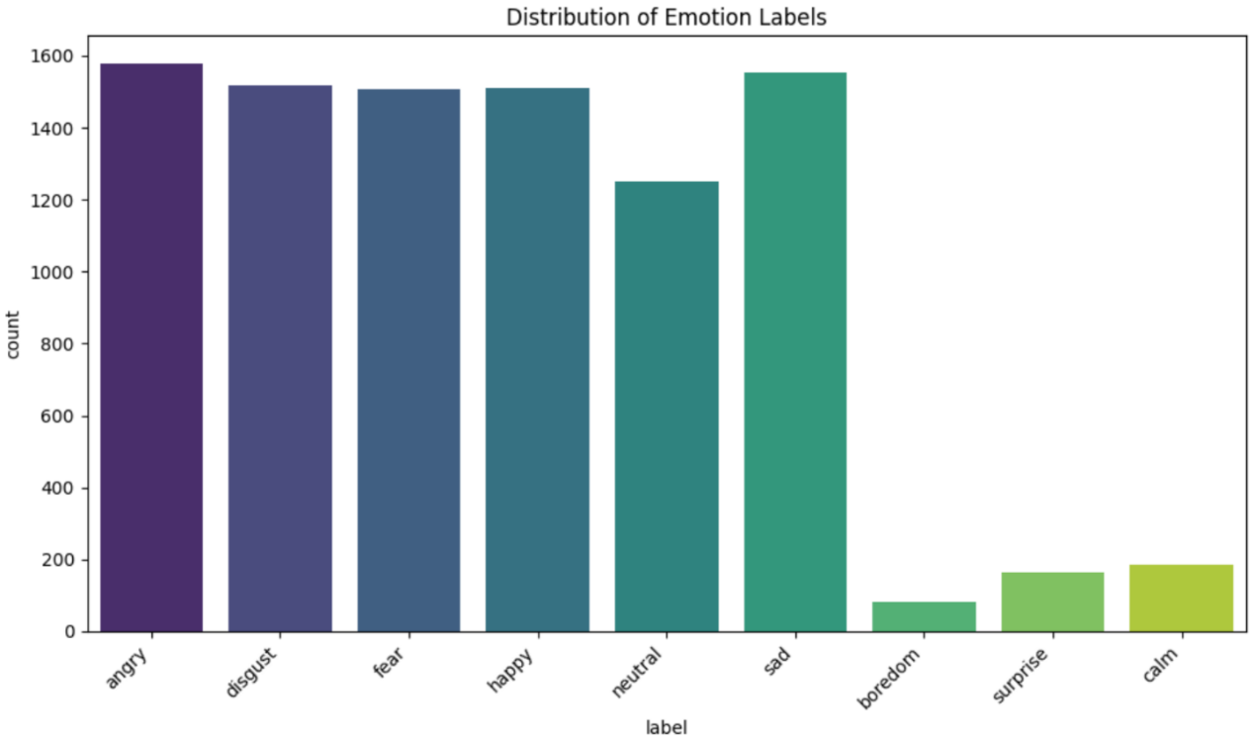
Techniques and Approaches
Feature Extraction
Modeling Approaches
Training and Evaluation
EDA
Imbalanced Emotion Distribution

Slide 21
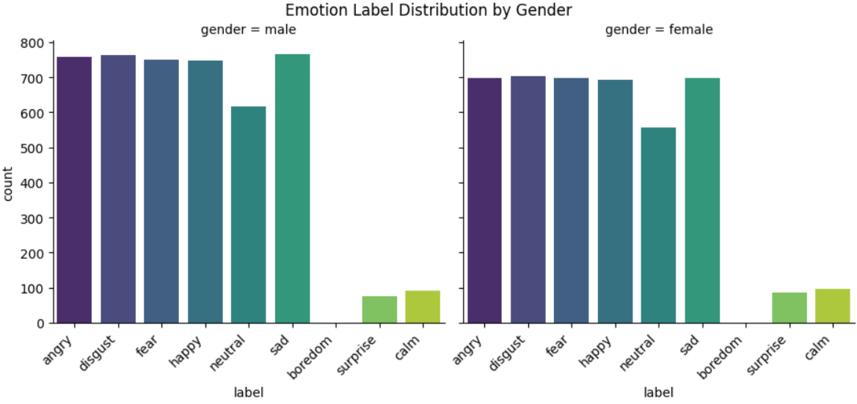
Techniques and Approaches
Feature Extraction
Modeling Approaches
Training and Evaluation
EDA
Gender 55% male, 45% female

Slide 22
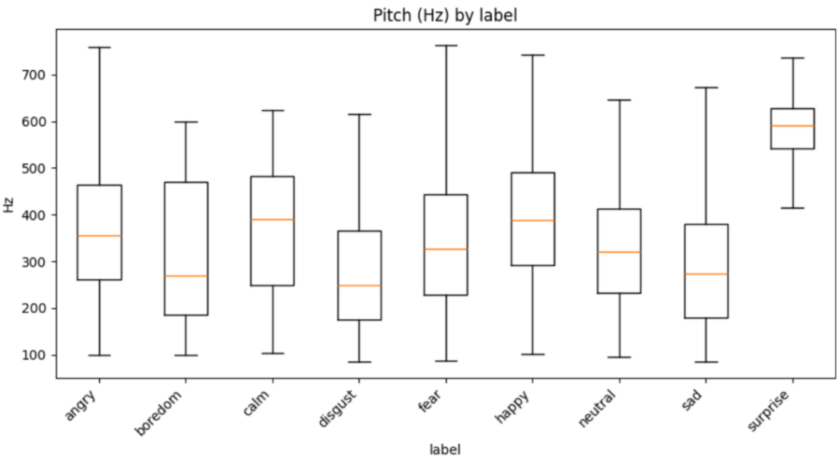
Techniques and Approaches
Feature Extraction
Modeling Approaches
Training and Evaluation
EDA
Pitch: higher in happy/surprise, lower in sad/neutral

Slide 23
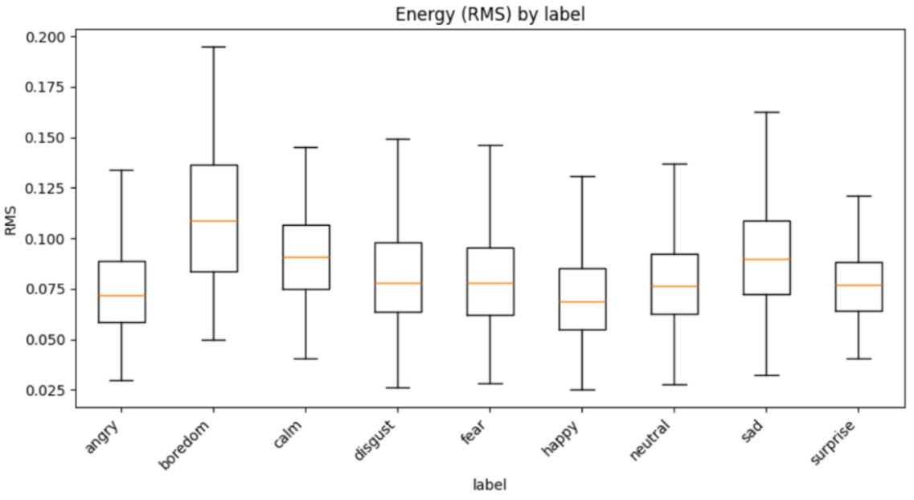
Techniques and Approaches
Feature Extraction
Modeling Approaches
Training and Evaluation
EDA
Energy: higher in angry/happy, lower in sad/calm

Slide 24
Introduction
Implementation and Results

Slide 25
Introduction
Implementation and Results
CNN
LSTM
CNN + LSTM
Random Forest Classifier
SVM

Slide 26
Convolutional Neural Network (CNN)
Captures Spatial Patterns in features.
Performed well on angry, sad.
Weak on subtle classes: Fear, Surprise, Disgust

Slide 27
Convolutional Neural Network (CNN)
Training and Validation Performance
Confusion Matrix
Summary

Slide 28
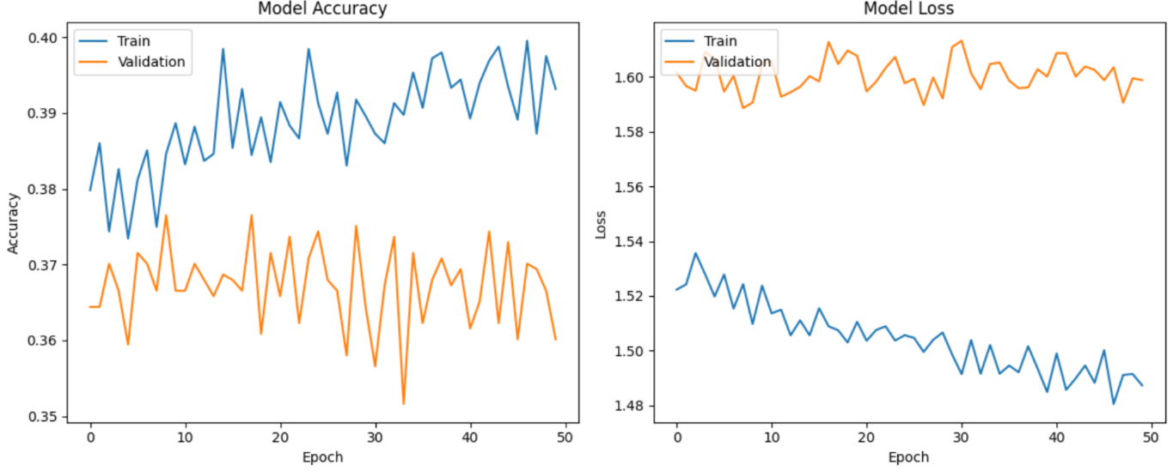
Convolutional Neural Network (CNN)
Training and Validation Performance
Confusion Matrix
Summary

Slide 29
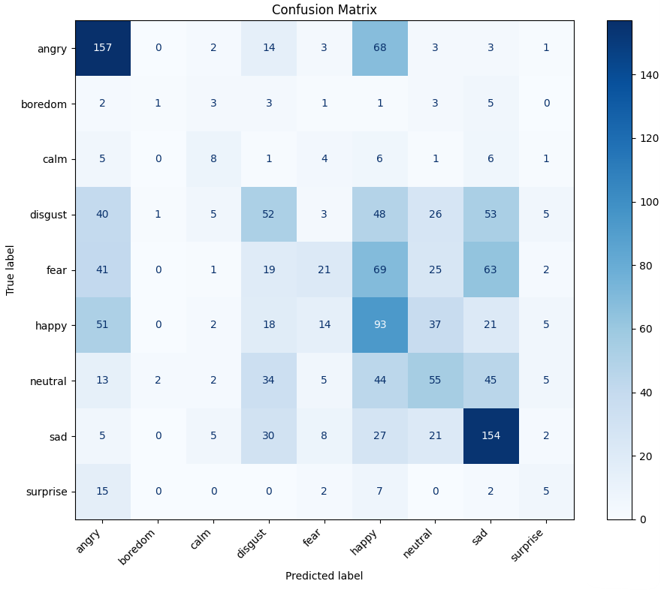
Convolutional Neural Network (CNN)
Training and Validation Performance
Confusion Matrix
Summary

Slide 30
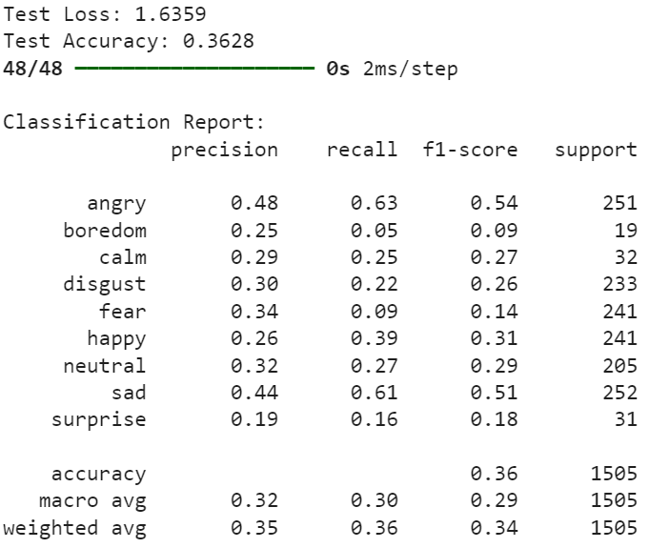
Convolutional Neural Network (CNN)
Training and Validation Performance
Confusion Matrix
Summary
Angry / Sad: Very strong, high accuracy
Happy: Moderate, often confused with Angry & Neutral
Neutral: Weak, misclassified as Sad/Happy
Fear / Disgust: Low, overlapping with other emotions
Surprise / Boredom: Very weak due to imbalance

Slide 31
Long Short-Term Memory (LSTM)
Learns temporal dependencies in speech
Improved on Fear & Sad compared to CNN
Struggled with Surprise, Calm, Boredom

Slide 32
Long Short-Term Memory (LSTM)
Captures Spatial Patterns in features.
Performed well on angry, sad.
Weak on subtle classes: Fear, Surprise, Disgust
Hyperparameter Tuning
Training and Validation Performance
Confusion Matrix
Summary of Results

Slide 33
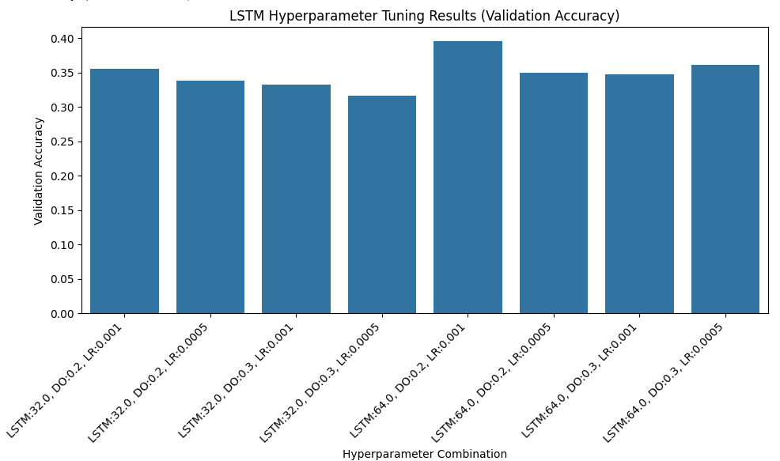
Long Short-Term Memory (LSTM)
Hyperparameter Tuning
Captures Spatial Patterns in features.
Performed well on angry, sad.
Weak on subtle classes: Fear, Surprise, Disgust
Training and Validation Performance
Confusion Matrix
Summary of Results

Slide 34
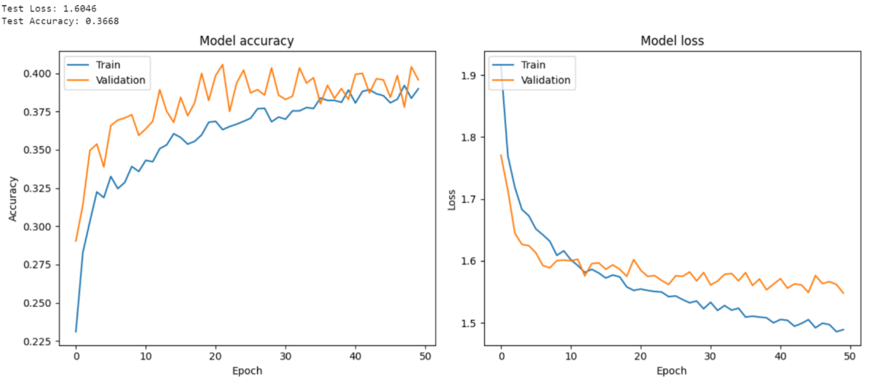
Long Short-Term Memory (LSTM)
Hyperparameter Tuning
Captures Spatial Patterns in features.
Performed well on angry, sad.
Weak on subtle classes: Fear, Surprise, Disgust
Training and Validation Performance
Confusion Matrix
Summary of Results

Slide 35
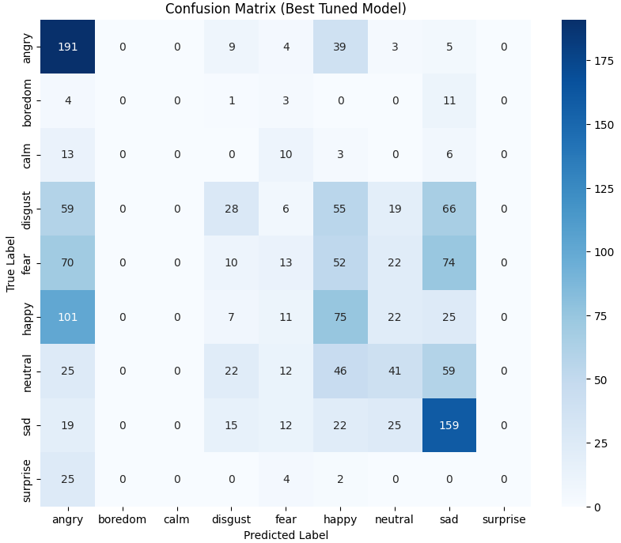
Long Short-Term Memory (LSTM)
Hyperparameter Tuning
Training and Validation Performance
Confusion Matrix
Summary of Results
Fear and Surprise were detected more accurately than in CNN, thanks to sequential modeling

Slide 36
Long Short-Term Memory (LSTM)
Hyperparameter Tuning
Angry / Sad: Excellent recognition (191, 159 correct)
Happy: Moderate, overlaps with Angry & Neutral
Neutral: Weak, scattered across multiple classes
Fear / Disgust: Low, frequent misclassifications
Calm / Boredom / Surprise: Very poor, failed on Surprise (0 correct)
Insight: Captures temporal patterns → boosts strong emotions, but imbalance hurts low-frequency classes
Captures Spatial Patterns in features.
Performed well on angry, sad.
Weak on subtle classes: Fear, Surprise, Disgust
Training and Validation Performance
Confusion Matrix
Summary of Results

Slide 37
CNN + LSTM Hybrid Model
Captures local spectral features (MFCCs & spectrograms)
Strong for Angry & Sad
Moderate for Happy, weak for Neutral
Very poor on Fear, Disgust, Surprise, Boredom

Slide 38
CNN + LSTM Hybrid Model
Architecture & Training Setup
Training and Validation Performance
Test-Set Performance
Confusion Matrix
Summary of Results

Slide 39
CNN + LSTM Hybrid Model
Architecture & Training Setup
Training and Validation Performance
Test-Set Performance
Confusion Matrix
Trained on MFCC features with speaker-independent splits
Loss/Optimizer: Categorical cross-entropy, Adam (lr = 1e-3)
Input preprocessing: Standardized with training set statistics
Overfitting control: Early stopping + validation monitoring
Evaluation: Accuracy + imbalance-aware metrics

Slide 40
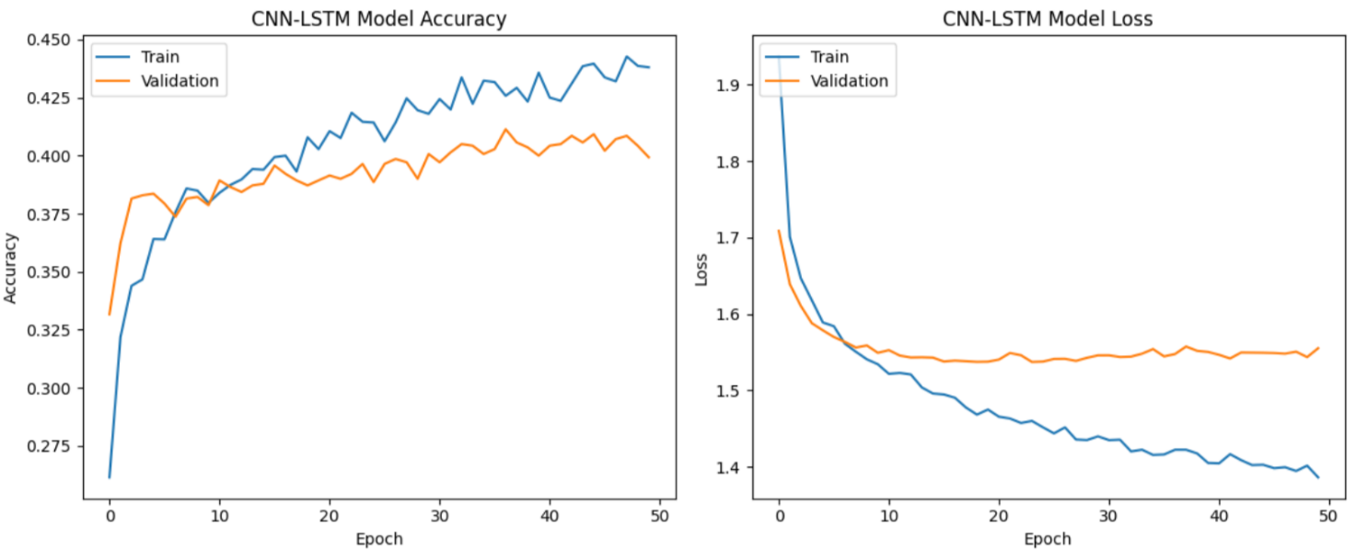
CNN + LSTM Hybrid Model
Architecture & Training Setup
Training and Validation Performance
Test-Set Performance
Confusion Matrix

Slide 41
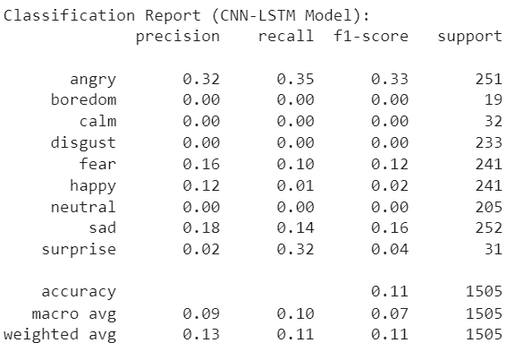
CNN + LSTM Hybrid Model
Architecture & Training Setup
Training and Validation Performance
Test-Set Performance
Confusion Matrix
Overall test accuracy: ~11%, macro F1: ≈ 0.07 (very low)
Recall: Moderate for Angry & Surprise
Near-zero for Boredom, Calm, Disgust, Neutral
Performance gap indicates class-prior collapse and/or label/feature mismatch

Slide 42
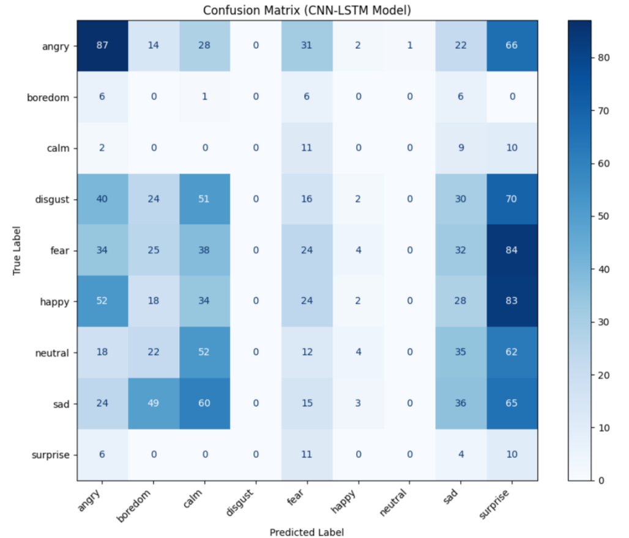
CNN + LSTM Hybrid Model
Architecture & Training Setup
Training and Validation Performance
Test-Set Performance
Confusion Matrix
Angry/Happy/Fear → often misclassified as Surprise
Neutral & Sad → overlap due to low-energy patterns
Boredom/Calm/Disgust → rarely predicted (minority collapse)
Causes: Class imbalance, limited temporal context

Slide 43
CNN + LSTM Hybrid Model
Summary of Results (CNN+LSTM)
Test performance very low: Accuracy ≈ 0.11, Macro-F1 ≈ 0.07
Confusions concentrated in high-arousal classes
Issues: single-timestep input, class imbalance

Slide 44
Random Forest Classifier
Hyperparameter Tuning
Training and Testing
Summary of Results

Slide 45
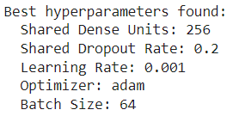
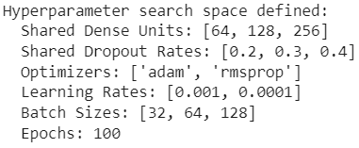
Random Forest Classifier
Hyperparameter Tuning
Training and Testing
Summary of Results

Slide 46
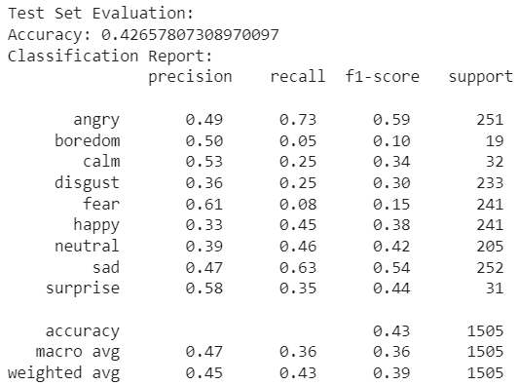
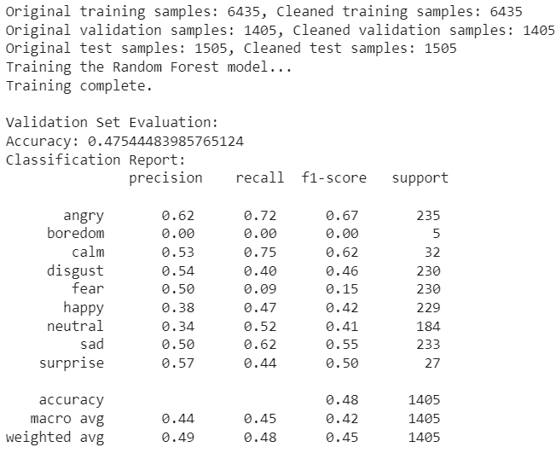
Random Forest Classifier
Hyperparameter Tuning
Training and Testing
Summary of Results

Slide 47
Random Forest Classifier
Hyperparameter Tuning
Training and Testing
Summary of Results
SVM performed best overall, strong on angry, calm, sad, surprise
Random Forest & deep learning had lower accuracy (47.5% & 42.6%)
Deep learning struggled with class imbalance but can improve with more data
SVM: highest macro-F1 & UAR, fast and consistent

Slide 48
Support Vector Machine (SVM)
Hyperparameter Tuning
Training and Testing Performance
Confusion Matrix
Summary of Results

Slide 49
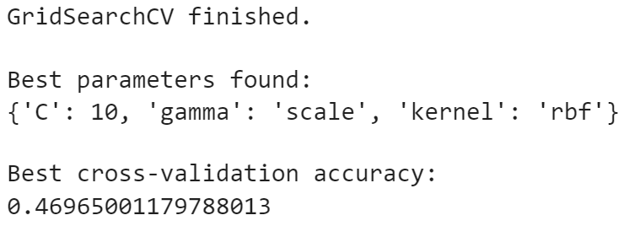
Long Short-Term Memory (LSTM)
Hyperparameter Tuning
Captures Spatial Patterns in features.
Performed well on angry, sad.
Weak on subtle classes: Fear, Surprise, Disgust
Training and Validation Performance
Confusion Matrix
RBF kernel with moderate regularization improved sadness & disgust; some overlap remains for angry/happy/fear
Summary of Results

Slide 50
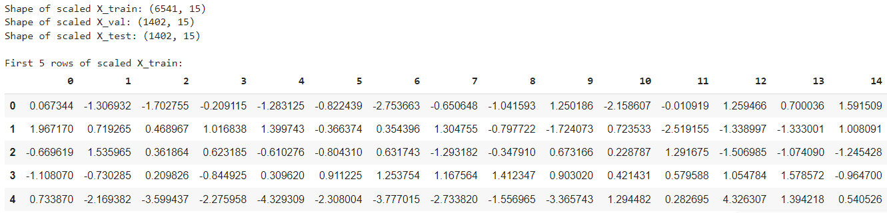
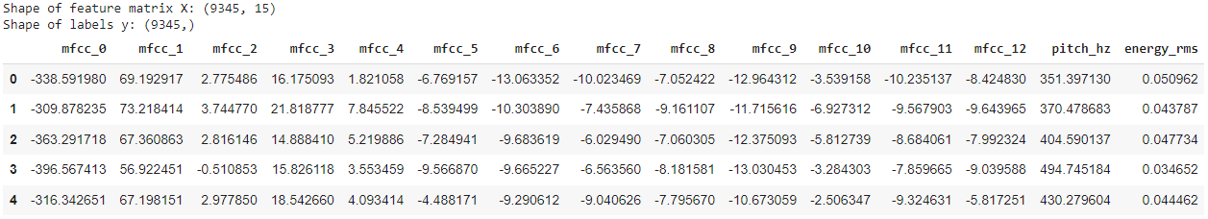
Long Short-Term Memory (LSTM)
Hyperparameter Tuning
Training and Validation Performance
Captures Spatial Patterns in features.
Performed well on angry, sad.
Weak on subtle classes: Fear, Surprise, Disgust
Confusion Matrix
Summary of Results

Slide 51
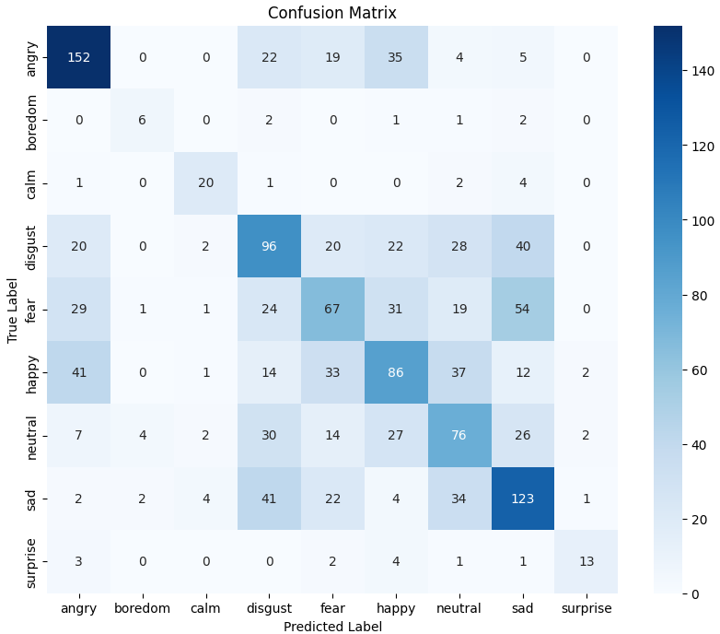
Long Short-Term Memory (LSTM)
Hyperparameter Tuning
Training and Validation Performance
Confusion Matrix
Summary of Results

Slide 52
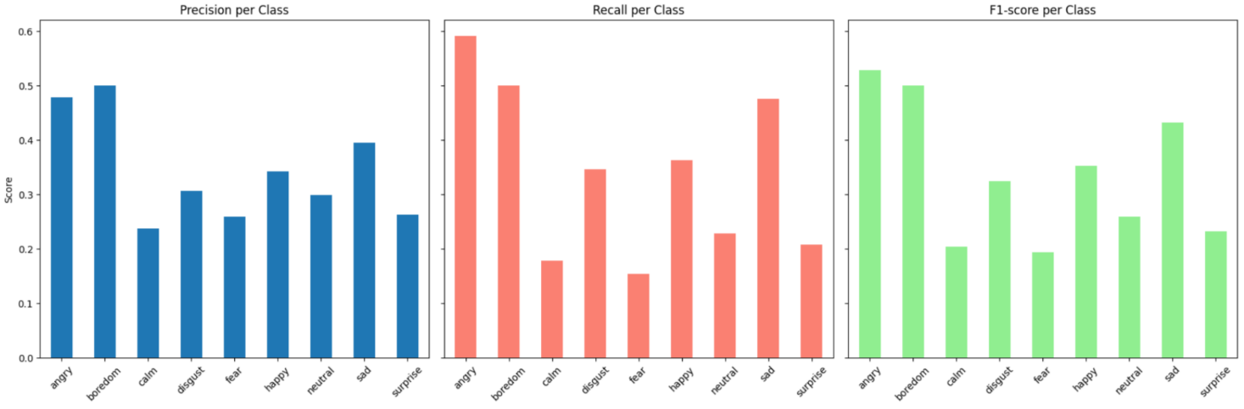
Long Short-Term Memory (LSTM)
Hyperparameter Tuning
Summary of Results
Captures Spatial Patterns in features.
Performed well on angry, sad.
Weak on subtle classes: Fear, Surprise, Disgust
Training and Validation Performance
Confusion Matrix

Slide 53
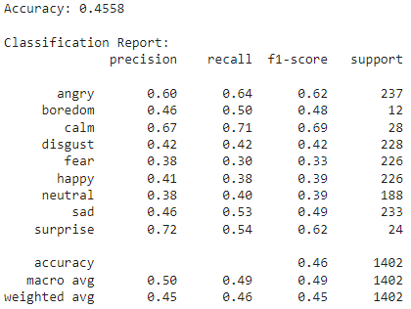
Long Short-Term Memory (LSTM)
Hyperparameter Tuning
Summary of Results
Captures Spatial Patterns in features.
Performed well on angry, sad.
Weak on subtle classes: Fear, Surprise, Disgust
Training and Validation Performance
SVM – Best Model: Excels on distinct emotions (sad, disgust); struggles with overlapping or subtle/underrepresented emotions (anger, fear, happy, boredom, calm, surprise)
Confusion Matrix

Slide 54
Introduction
Model Demonstration

Slide 55
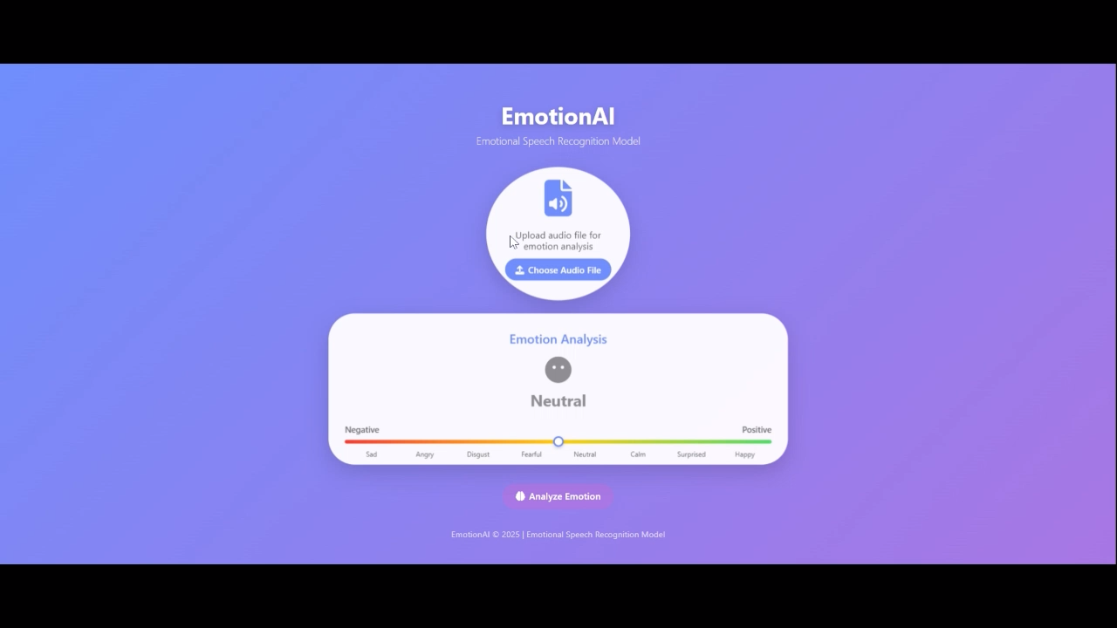
Introduction
Model Demonstration

Slide 56
Introduction
References
Burnwal, S. (2018). Speech emotion recognition. Kaggle. https://www.kaggle.com/code/shivamburnwal/speech-emotion-recognition
Dincer, B. (2021). Emotional speech recognition / AUDIO PROCESS / ALL. Kaggle. https://www.kaggle.com/code/brsdincer/emotional-speech-recognition-audio-process-all
University of South California. (2004) IEMOCAP Database. https://sail.usc.edu/iemocap/
PLOS One. (2018). RAVDESS Database, official paper. https://journals.plos.org/plosone/article?id=10.1371/journal.pone.0196391
NIH. (2015). CREMA-D database paper. https://pmc.ncbi.nlm.nih.gov/articles/PMC4313618/
Kaggle. CREMA-D database. https://www.kaggle.com/datasets/ejlok1/cremad
GitHub. (2018). CREMA-D Demographs dataset. https://github.com/CheyneyComputerScience/CREMA-D/blob/master/VideoDemographics.csv
Librosa. (2015). librosa docs. https://librosa.org
OpenSmile. (2022). Opensmile doc. https://audeering.github.io/opensmile/
OpenAI. (2025). ChatGPT (GPT-5) [Large language model]. https://chat.openai.com/
Google. (2025). Gemini [Large language model]. https://gemini.google.com/

Slide 57
Introduction
Thank You

